Slide 1
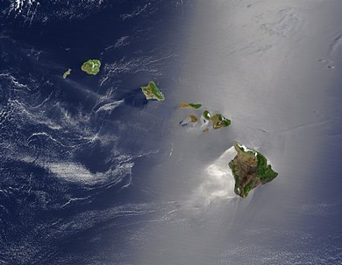
Hawaiian Islands
By Loz Mckenzie

Slide 2
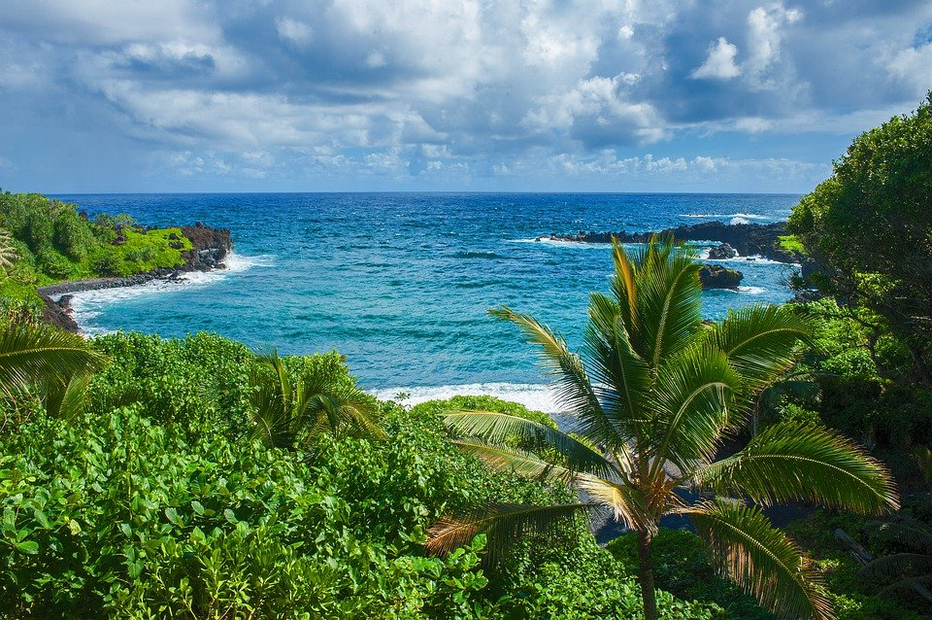
Where were the Hawaiian Islands formed?
Hawaii

Slide 3
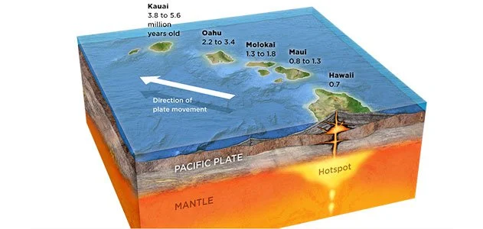
How Hawaiian Islands were formed?
Formed 30 million years ago
Hotspots
Volcanoes
Underwater volcanoes
Lava

Slide 4
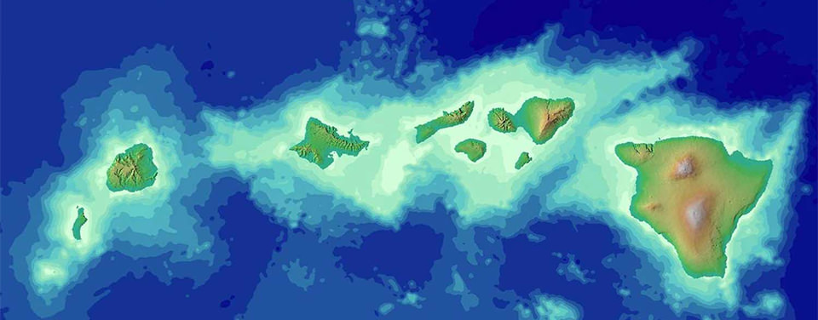
What plate created the Hawaiian Islands?
The Pacific Plate
A Hotspot
The Pacific Plate can make more Hawaiian islands

Slide 5
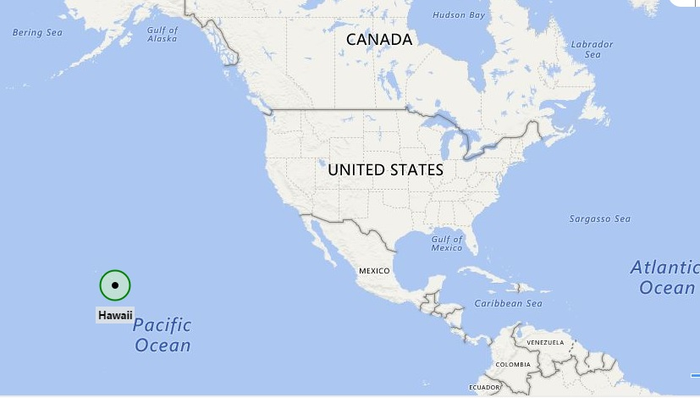
Where can you find Hawaii Islands?
USA
2100 miles southwest from America
Pacific Ocean
Oceania

Slide 6
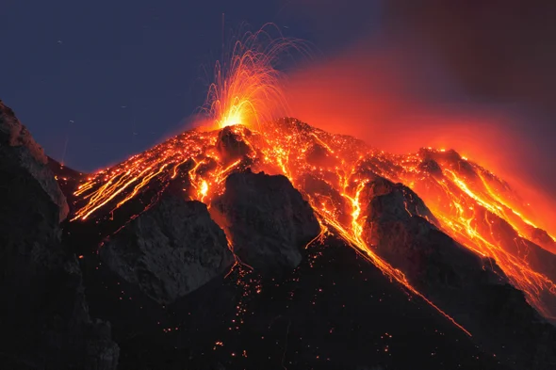
What activities are going on in Hawaii?
Volcanoes
Hawaii can’t have earthquakes
The volcanoes can create new islands
The volcanoes can erupt at any time

Slide 7
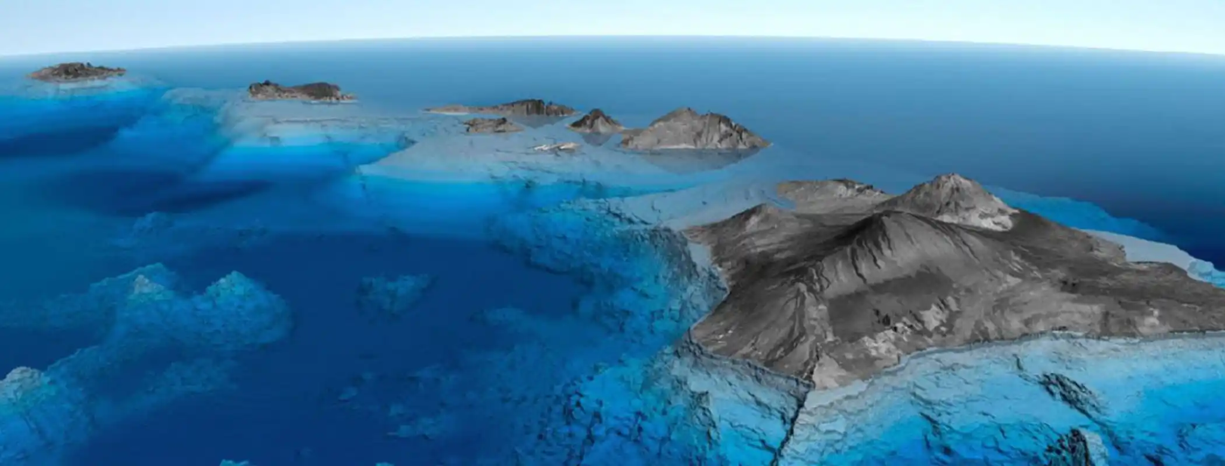
Do geologists study Hawaiian Islands?
Volcanologists study volcanoes
The chain of volcanic islands appearing
Geologists study the Pacific Ocean

Slide 8
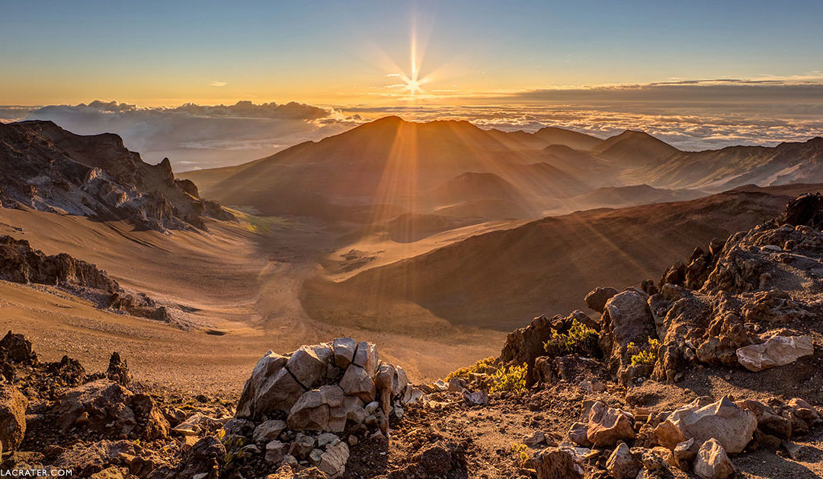
5 interesting Facts about Hawaiian Islands
Mount Haleakala is the largest dormant volcano
Two official languages
Many volcanoes
Surfing invented
You can mail a coconut

Slide 9
Work Cited
https://en.wikipedia.org/wiki/Hawaiian_Islands
https://oceanservice.noaa.gov/facts/hawaii.html
https://www.smithsonianmag.com/travel/what-were-still-learning-about-hawaii-74730/
https://www.americanoceans.org/facts/how-was-hawaii-formed/
https://www.nationalgeographic.org/article/chain-islands-hawaiian-hot-spot/#:~:text=In%20the%20case%20of%20the,chain%20of%20islands%20to%20form.
Google Image Search
https://haleakalacrater.com/legends-of-haleakala-maui/

Slide 10
Work Cited
Continued
https://www.whereig.com/usa/states/hawaii/
https://health.hawaii.gov/prepare/natural-disasters/earthquakes/#:~:text=Volcanic%20activity%20in%20Hawaii%20makes,Big%20Island%20in%20May%202018.
https://www.scientificamerican.com/article/volcano-letting-off-steam/
https://www.travelibn.com/hawaii-geology#:~:text=Geology%20of%20the%20Hawaiian%20Islands&text=A%20magnet%20for%20geologists%2C%20volcanologists,the%20history%20of%20our%20planet.
https://www.hawaii-guide.com/content/posts/hawaii_geology_and_geography
https://www.mauiaccommodations.com/blog/20-quirky-facts-about-hawaii/

